Slide 1
Enthalpy change
Chapter 4

Slide 2
enthalpy
Please write
Is the total energy of a system.
E_{k}= Kinetic energy.
Vibrational
Rotational
Translational
∆H is the change in total energy of the system during a rxn or phase change.
Most of the E exchanged is in the form of heat!
$$H=E_{k}+E_{p}$$
E_{P}= Potential energy
Attractive force b/w nucleons & electrons
E stored by the bonds between atoms & molecules.
E due to motion
Therefore we use the change in heat as a indicator of the change in enthalpy expressed per mol!
$$\frac{Q}{mol}= ∆H$$
at constant T & P

Slide 3
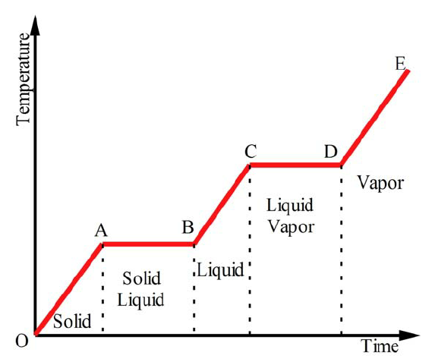
∆h – phase changes
Please sketch
Change in E_{p}
Energy breaks intermolecular bonds
Energy increases the speed of molecules
Change in E_{k}

Slide 4
How To calculate ∆h melting ice → vapour
Please write
Q_{ice} = mc∆T (c=2.05 J/g℃)
+
At the melting point ∆H = 6.01kJ/mol until all the ice is melted!
+
Q_{water} = mc∆T (c=4.19 J/g℃)
+
At the boiling point ∆H = 40.66 kJ/mol until all the water is vaporised!
+
Q_{vapour} = mc∆T (c=1.41 J/g℃)

Slide 5
Gas
Please sketch
Vaporization
Endothermic
Process
Exothermic
Process
Solid Condensation
Liquid Condensation
Sublimation
Terminology
for
phase changes
Liquid
Solid
Melting (fusion)
Liquid
Freezing (solidification)

Slide 6
Heat Curve of a Pure Substance
observe
150
140
130
120
110
100
90
80
70
60
50
40
30
20
10
0
-10
-20
-30
-40
-50
Boiling Point
gas
liquid & gas
Temperature (°C)
ΔT_{(l)}
Melting Point
liquid
$c_{(l)}$=$\frac{{∆H}_{(l)}}{{∆T}_{(l)}}$
solid & liquid
Specific heat capacity of the liquid can be determined from the inverse slope of the curve
solid
ΔH_{fus}
ΔH_{(l)}
ΔH_{vap}
Heat of fusion
Heat of vaporization
100 200 300 400 500 600 700 800 900 1000 1100 1200 1300 1400 1500 1600
Energy absorbed by substance (joules / gram)

Slide 7
Reversing a Heat Curve
observe
If instead we cool a hot gaseous substance….
boiling point → condensation point.
heat of vaporization --> heat of condensation.
150
140
130
120
110
100
90
80
70
60
50
40
30
20
10
0
-10
-20
-30
-40
-50
gas
Condensation point
liquid & gas
melting point → freezing point.
heat of vaporisation → heat of solidification.
liquid
Temperature (°C)
Freezing Point
solid & liquid
ΔH_{cond}
ΔH_{s}
solid
Heat of condensation
Heat of solidification
100 200 300 400 500 600 700 800 900 1000 1100 1200 1300 1400 1500 1600
Energy (joules / gram) released

Slide 8
Important pts from a Heat Curve:
Please write
The melting/freezing point temperature (1st plateau)
The boiling point temperature/vaporization/condensation/ (2nd plateau)
The heat of fusion (ΔH_{fus}) or solidification (ΔH_{s}) (change in x-axis)
The heat of vaporization (ΔH_{vap}) or condensation (ΔH_{cond}) (x-axis)
The specific heat capacity (c) of the solid or liquid substance.
Calculated from the ∆H/g and ∆T from the inverse slope
Since Q=mc∆T & Q/m = ∆H(J/g) from the graph so
$c=\frac{\text{∆}H}{\text{∆}T}$

Slide 9
Heat Curve of a Mixture
The heat curve of a mixture of substances.
The mixture “melts” over a range of temperatures, and each component “boils” at a different temperature.
150
140
130
120
110
100
90
80
70
60
50
40
30
20
10
0
-10
-20
-30
-40
-50
Fractional Distillation #3
Fractional Distillation #2
gas
Fractional Distillation #1
Boiling range
We can use the different boiling temperatures of the mixtures components to separate them by capturing the vapours separately—a process called fractional distillation.
Temperature (°C)
liquid
Melting Range
slushy
The mixture melts more gradually than pure matter.
solid
100 200 300 400 500 600 700 800 900 1000 1100 1200 1300 1400 1500 1600
Energy absorbed by substance (joules / gram)

Slide 10
Sample Problem imaginary heat curve
Use the heat curve to determine:
The melting point
The boiling point
The specific heat capacity of liquid
the heat of fusion of
the heat of vaporization of
150
140
130
120
110
100
90
80
70
60
50
40
30
20
10
0
-10
-20
-30
-40
-50
Temperature (°C)
100 200 300 400 500 600 700 800 900 1000 1100 1200 1300 1400 1500 1600
Energy absorbed by substance (joules / gram)

Slide 11
Sample Problem imaginary heat curve
Please glue into notes and solve
Use the heat curve to determine:
The melting point
The boiling point
The specific heat capacity of liquid
the heat of fusion of
the heat of vaporization of this substance
150
140
130
120
110
100
90
80
70
60
50
40
30
20
10
0
-10
-20
-30
-40
-50
Answers:
–20°C
+70°C
4.44 J/g°C
200 J/g*
400 J/g*
ΔT_{(l)} = (70-(-20)) =90℃
Temperature (°C)
ΔH_{(l)} = (900-500) =400J/g
$c_{(l)}$=$\frac{400 J/g}{90℃}$ = 4.44 J/g℃
ΔH_{fus}= (500–300)= 200 J/g
ΔH_{vap}=(1300-900)=400 J/g
Heat of fusion
Heat of vaporization
100 200 300 400 500 600 700 800 900 1000 1100 1200 1300 1400 1500 1600
Energy absorbed by substance (joules / gram)
*Heat of fusion and vaporization are given in J/g.
To convert to the more standard form ( J/mol) we could multiply this answer by the molar mass.

Slide 12
Worksheet due next class

Slide 13
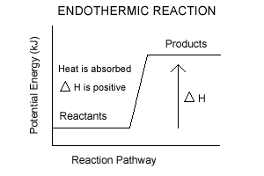
Today:
Expressing ∆H as a simplified graph
Expressing ∆H within a rxn

Slide 14
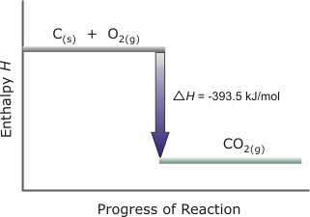
Please write/sketch
Exothermic Rxn
The bonds in C + O₂ contain more energy than the bonds in CO₂.
Energy is released (exothermic)(∆H is neg)
Written as:
C _{(s)} + O_{2 (g)} →CO_{2 (g)} + 393.5 kJ/mol
or
C _{(s)} + O_{2 (g)} →CO_{2 (g)} ∆H= -393.5 kJ/mol

Slide 15
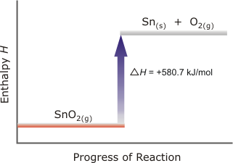
Endothermic Rxn
Please write/sketch
The bonds in SnO₂ contain less energy than the bonds in Sn + O₂.
Energy is absorbed (endothermic)(∆H is pos)
Written as:
SnO_{2 (g)} + 580.7 kJ/mol →Sn_{(s)} + O_{2 (g)}
or
SnO_{2 (g)} →Sn_{(s)} + O_{2 (g)} ∆H= 580.7 kJ/mol

Slide 16
Examples
Please write & do this exercise
Determine the sign of ∆H; state exothermic or endothermic & draw energy diagram for each of the following:
H_{2(g)} + ½ O_{2(g)} → H₂0_{(g)} + 285.8kJ/mol
40.7kJ/mol + H₂0_{(l)} → H₂0_{(g)}
When nitroglycerine decomposes, it causes a violent explosion, releasing 5.72 x 10³kJ of heat for each mole.
C₃H₅(NO₃)₃ → 3CO₂ + 5/2 H₂O + ¼O₂ + 3/2N₂

Slide 17
H₂(g) + ½ O₂(g) → H₂0(g) + 285.8kJ
1.
∆H = -285.8 kJ → is negative
Reaction is exothermic
Graph
H_{2(g)} + ½ O_{2(g)}
∆H = -285.8 kJ
∆H (kJ)
H₂0_{(g)}
Reaction path →

Slide 18
40.7kJ + H₂0(l) → H₂0(g)
2.
∆H is positive
Reaction is endothermic
Graph
H₂0_{(g)}
∆H = 40.7 kJ
∆H (kJ)
H₂0_{(l)}
Reaction path →

Slide 19
3.
∆H is negative
Reaction is exothermic
C₃H₅(NO₃)₃ → 3CO₂ + 2.5 H₂O + ¼O₂ + 1.5N₂
C₃H₅(NO₃)₃
∆H = -5.72 x 10³ kJ/mol
∆H (kJ)
3CO₂ + 5/2 H₂O + ¼O₂ + 3/2N₂
Reaction path →

Slide 20
We will be studying…..
Expressing ∆H as a graph and calin 4 different ways
Q = mc∆T & $∆H=\frac{Q}{n}$ Q = energy expressed in Joules. ∆H = energy expressed in Joules/mol.
Using table with${∆H}_{f} ∆H_{rxn}={∆H}_{f}\left(products\right)−∆H_{f}(reactants$)
Using bond energies $∆H_{rxn}=\left(\sum{E of broken bonds}\right)−(\sum{E of bonds formed}$)
Hess’s Law (adding known equations)
☑

Slide 21
Please write
Using a calorimeter chemist have formed appendices @SATP for:
Heat of formation (∆H_{f}) = energy stored in a substance during its formation from elements
Heat of fusion (∆H_{fus})
Heat of vaporisation (∆H_{vap})
Heat of dissolution (∆H_{d})
Heat of combustion (∆H_{comb})
Heat of a certain reaction (∆H_{rxn})
etc
melting
boiling
Textbook
appendix 8

Slide 22
Hand-out Blue table!
Please note!
The heat of formation (∆H_{f}) is the energy stored in a substance during its formation from elements.
So substances in their elemental form have a ∆H_{f} = 0.
∆H_{f} of O₂= 0.
∆H_{f} of Ag = 0. The solid metal not the ion!
∆H_{f} of CO= -110.5 kJ/mol because it is made from C + O₂

Slide 23
How do you calculate ∆H_{rxn} from ${∆H}_{f}$?
Please write
$∆H_{rxn}={∆H}_{f}\left(products\right)−∆H_{f}(reactants$)
Ex 1. CH_{4 (g)} + 2O_{2 (g)} → CO_{2 (g)} + 2H₂O _{(l)}
$∆H_{rxn}={∆H}_{f}\left(products\right)−∆H_{f}(reactants$)
= (-393.5 + 2(-285.8))-((-74.4) + 2(0))
= (-965.1) – (-74.4)
= -890.7 kJ/mol of methane
+ 890.7 kJ/mol
☑
Graph
${∆H}_{f}$
Bond energies
Hess’s Law
Exothermic!
☑

Slide 24
Please write
Ex 2. H_{2 (g)} + Cl_{2 (g)} → 2HCl _{(g)}
$∆H_{rxn}={∆H}_{f}\left(products\right)−∆H_{f}(reactants$)
= (2(-92.3))-(0 + 0)
= (-184.6) – (0)
= -184.6 kJ/mol of hydrogen
$∆H_{rxn}$ = - 184.6 kJ/mol
Exothermic!

Slide 25
Stop Worksheet use table of ∆H_{f} to solve

Slide 26
How do you calculate ∆H_{rxn} from bond energies?
☑
Graph
${∆H}_{f}$
Bond energies
Hess’s Law
Please write
☑
☑
Find the energy difference in making and breaking bonds.
Based on average bond enthalpies.
Provides a rough estimate!
$∆H_{rxn}=\left(\sum{E of broken bonds}\right)−(\sum{E of bonds formed}$)

Slide 27
Ex 3. H_{2 (g)} + Cl_{2 (g)} → 2HCl _{(g)}
$∆H_{rxn}=\left(\sum{E of broken bonds}\right)−(\sum{E of bonds formed}$)
Bond | Energy
H-H | 436 kJ/mol
H-O | 460 kJ/mol
H-F | 570 kJ/mol
H-Cl | 432 kJ/mol
C-H | 413 kJ/mol
C-C | 347 kJ/mol
C=C | 607 kJ/mol
C-O | 358 kJ/mol
O=O | 498 kJ/mol
C=O | 745 kJ/mol
Cl-Cl | 243 kJ/mol
N=N | 418 kJ/mol
N=O | 631 kJ/mol
= (436 + 243)-(2(432))
= (679) – (864)
= -185 kJ/mol of hydrogen
2x
P 419 →

Slide 28
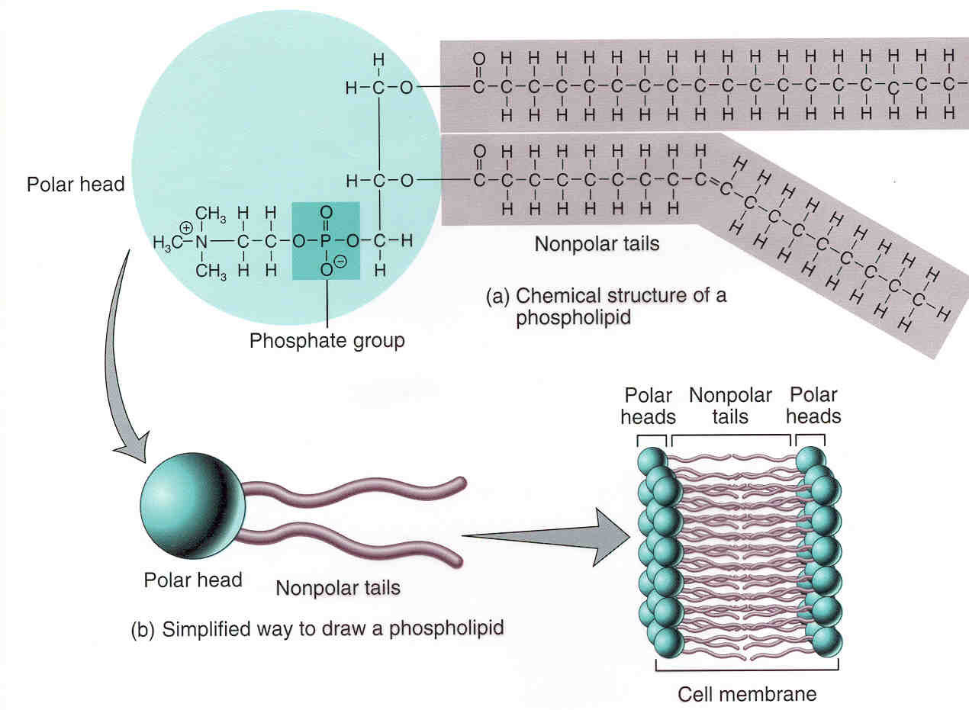
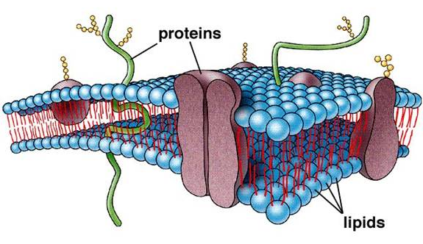
Why do an estimate????
Can’t find ${∆H}_{f}$
Dealing with a macromolecule

Slide 29
Use bond energies to determine the enthalpy of the following rxns.
2H₂ + O₂ → 2 H₂O
Please write
Bond | Energy
H-H | 436 kJ/mol
H-O | 460 kJ/mol
H-F | 570 kJ/mol
H-Cl | 432 kJ/mol
C-H | 413 kJ/mol
C-C | 347 kJ/mol
C=C | 607 kJ/mol
C-O | 358 kJ/mol
O=O | 498 kJ/mol
C=O | 745 kJ/mol
Cl-Cl | 243 kJ/mol
N=N | 418 kJ/mol
N=O | 631 kJ/mol
$∆H_{rxn}=\left(broken\right)−(formed$)
= (2(436) + 498) – (4(460))
= (1370) – (1840)
= -470 kJ/mol
$∆H_{rxn}=\left(broken\right)−(formed$)
= (5(413)+347+358+460) – (4(413)+607+2(460))
= (3230) – (3179)
= 51 kJ/mol
Lewis dot diagrams help to determine what bonds are present.

Slide 30
Stop - practice

Slide 31
To Make:
S_{(s)} + $\frac{3}{2}$ O_{2(g)} → SO_{3(g)}
Some reactions occur in multiple steps.
Each step has an enthalpy value.
S_{(s)} + O_{2(g)} → SO_{2(g)}
∆H = -296.8kJ
SO_{2(g)} + ½ O_{2(g)} → SO_{3(g)}
∆H = -99.2kJ

Slide 32
Please write
Hess’ Law of Constant Heat Summation:
The enthalpy of a rxn is the same whether it happens in one step or in a series of steps.
Therefore enthalpy values of known rxns can be added to give the enthalpy of a needed rxn.
S_{(s)} + O_{2(g)} → SO_{2(g)}
∆H = -296.8kJ/mol
SO_{2(g)} + ½ O_{2(g)} → SO_{3(g)}
∆H = -99.2kJ/mol
+
S_{(s)} + $\frac{3}{2}$ O_{2(g)} → SO_{3(g)}
∆H = -396kJ/mol

Slide 33
Please write
Rules for rearranging equations:
Step 1: Rewrite so that the reactants & products are on the desired side. (Switch sign of ∆H when reversing an equation)
Step 2: Adjust for the # of moles by multiplying the entire equation. (You also multiply the ∆H value!)

Slide 34
You are given….
C_{(s)} + O_{2(g)} → CO_{2(g)} ΔH = -393.5 kJ/mol
CO_{(g)} + ½ O_{2(g)} → CO_{2(g)} ΔH = -283.0 kJ/mol
Use the above rxns to “create” the desired reaction & calculate the enthalpy
½O₂
C_{(s)} + O_{2(g)} → CO_{2(g)} ΔH = -393.5 kJ/mol
+
CO_{2(g)} → CO_{(g)} + ½ O_{2(g)} ΔH = +283 kJ/mol
C_{(s)} + ½ O_{2(g)} → CO_{(g)} ΔH = ?
We want →
∆H = -110.5 kJ/mol

Slide 35
Please write
Given:
2 Al_{(s)} + 3/2 O_{2(g)} → Al₂O_{3(s)} ΔH = ‑1675 kJ/mol
2 Fe_{(s)} + 3/2 O_{2(g)} → Fe₂O_{3(s)} ΔH = ‑ 838 kJ/mol
Calculate the unknown ΔH for the reaction below.
Fe₂O_{3(s)} + 2 Al_{(s)} → Al₂O_{3(s)} +2 Fe_{(s)}

Slide 36
ΔH = ‑1675 kJ/mol
2Al_{(s)} + 3/2O_{2(g)} → Al₂O_{3(s)}
Fe₂O_{3(s)} → 2 Fe_{(s)}+ 3/2 O_{2(g)}
ΔH = +838 kJ/mol
+
Fe₂O_{3(s)} + 2 Al_{(s)} → Al₂O_{3(s)} +2 Fe_{(s)}
ΔH = -837 kJ/mol

Slide 37
Ex. The formation of nitric acid is given by the following equation:
12NH₃ + 21O₂ → 8HNO₃ + 4NO + 14H₂O
Given the equations below, calculate the ΔH for nitric acid.
NH₃ + 5/4 O₂ → NO + 3/2H₂O ΔH = -293 kJ/mol
NO + ½ O₂ → NO₂ ΔH = -59 kJ/mol
NO₂ + 1/3H₂O → 2/3HNO₃ + 1/3NO ΔH = -45 kJ/mol

Slide 38
12
12
14
NH₃ + 5/4 O₂ → NO + 3/2H₂O ΔH = -293 kJ
x12
15
18
∆H = -3516 kJ
12
NO₂ + 1/3H₂O → 2/3HNO₃ + 1/3NO ΔH = -45 kJ
x12
4
8
4
∆H = -540 kJ
12
NO + ½ O₂ → NO₂ ΔH = -59 kJ
x12
6
12
∆H = -708 kJ
+
12NH₃ + 21O₂ → 8HNO₃ + 4NO + 14H₂O
ΔH = - 4,764 kJ/mol

Slide 39
Please write
We have found four ways to calculate enthalpy, ∆H:
Q = mc∆T & $∆H=\frac{Q}{n}$ Q = energy expressed in Joules. ∆H = energy expressed in Joules/mol.
$∆H_{rxn}={∆H}_{f}\left(products\right)−∆H_{f}(reactants$)
$∆H_{rxn}=\left(\sum{E of broken bonds}\right)−(\sum{E of bonds formed}$)
Energy is needed to break bonds but is released when bonds are formed.
Therefore the equation is energy absorbed – energy released.
$∆H_{rxn}$ = positive # means more E is absorbed $∴$ endothermic rxn
$∆H_{rxn}$ = negative # means more E is released $∴$ exothermic rxn
Hess’s Law

